Slide 1
Determining Critical Workers Compensation Claims: A Big Data Approach
Patrick Brehm
Sneha Dingre
Vineeth Dodla
Abhilash Gandham
Nicholas Morris
Shravani Reddy
Li Yicheng

Slide 2
Objective: Provide Strategic Recommendations for Claims Processing Organization
Provide recommendations to help organization become an Analytics 3.0 competitor.
Our approach: get a final dataset based on requirements, then create model from dataset.

Slide 3
Our Model: Decision Tree
Intuitive to follow
Easy for non Data Scientists to use
Balance between accuracy and simplicity

Slide 4
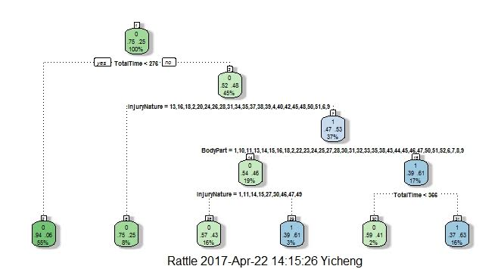
Our Model

Slide 5
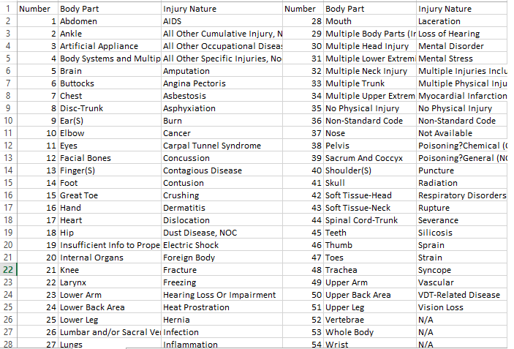

Slide 6
Initial Hypotheses
Knee and back injuries will be the most common
Body Part will determine Paid compensation
Total Time will determine Paid compensation
Body Part will determine Average Total Loss

Slide 7
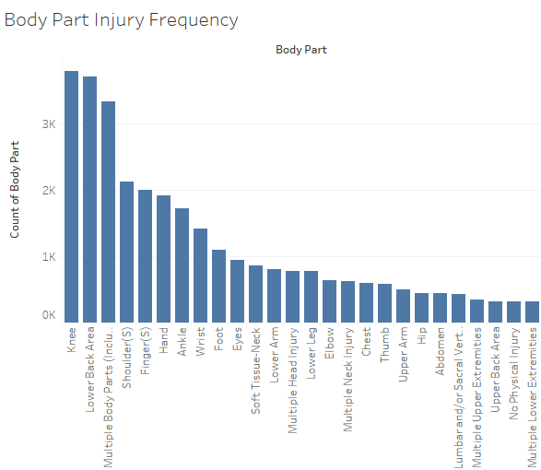

Slide 8
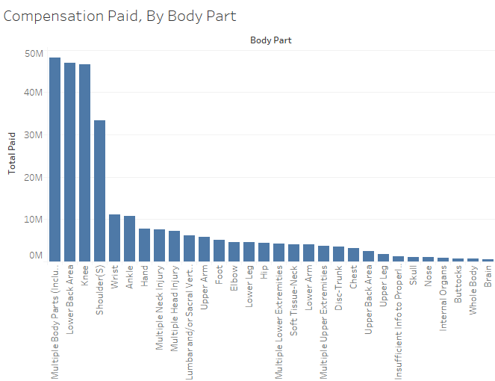

Slide 9
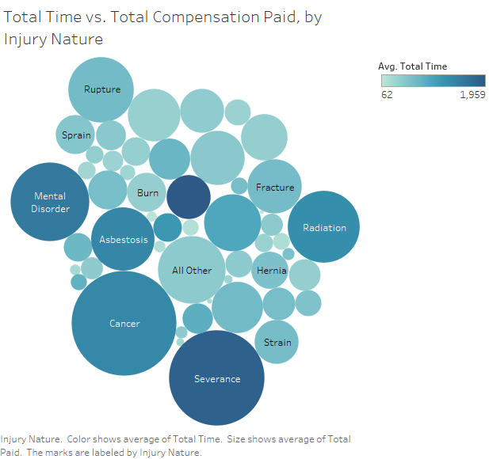

Slide 10
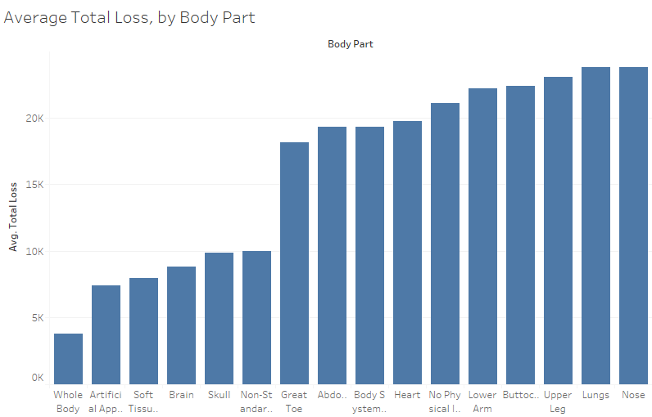

Slide 11
Data Cleaning
Total Loss and Total Cost per Day variables were created.
NA values and age < 17 were removed for Claimant Age.
Critical column was added for top 25 percentile of Total Paid.

Slide 12
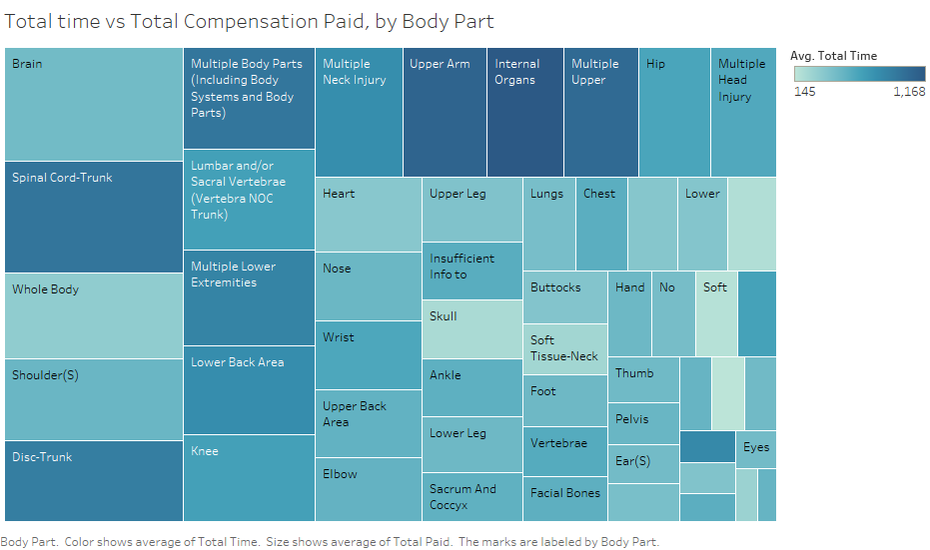

Slide 13
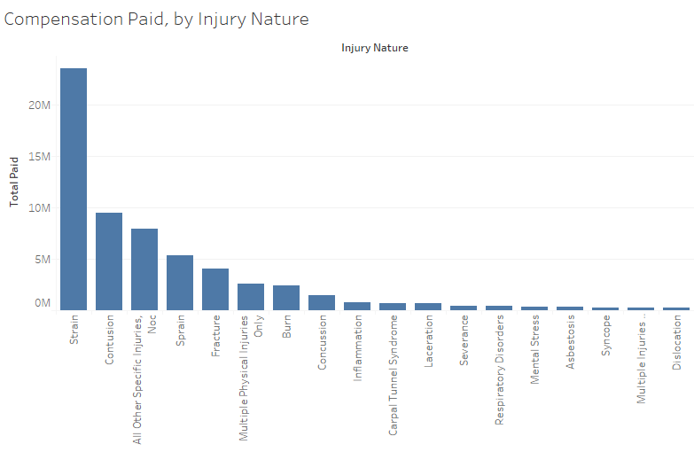

Slide 14
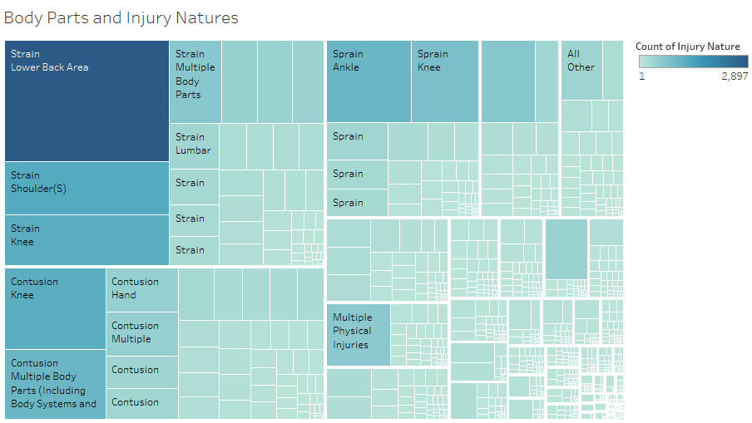

Slide 15
Possible Models
Logistic Regression - Predictions are either 0 or 1, so this would help determine if an injury is critical.
Decision Tree - Different paths lead to either 0 or 1, also a good way to determine critical injuries.
Clustering - Creates groups, it would have to be binary groups so probably not the best model.

Slide 16
Our Recommendation: Decision Tree Model
Effective and easy to follow visually
Can be used to predict if a claim is Critical or not
“Critical” means a claim will be in the top 25% of all claims in terms of total payout by the insurance company

Slide 17
Results
Certain parts (abdomen, eye) tend to produce more critical injuries
Ideal Total Time is between 276 and 366 days
Most paid injuries produce more critical injuries if body part is less significant

Slide 18
Recommendations
Hire a C-level executive to lead data analysis
Invest in text analysis
Design tests for critical claims using decision trees
Implement machine learning for predictive models

